Slide 1

BHEEMANNA KHANDRE INSTITUTE OF TECHNOLOGY BHALKI
DEPARTMENT OF ELECTRONICS &COMMUNICATION
ENGNEERING

Slide 2
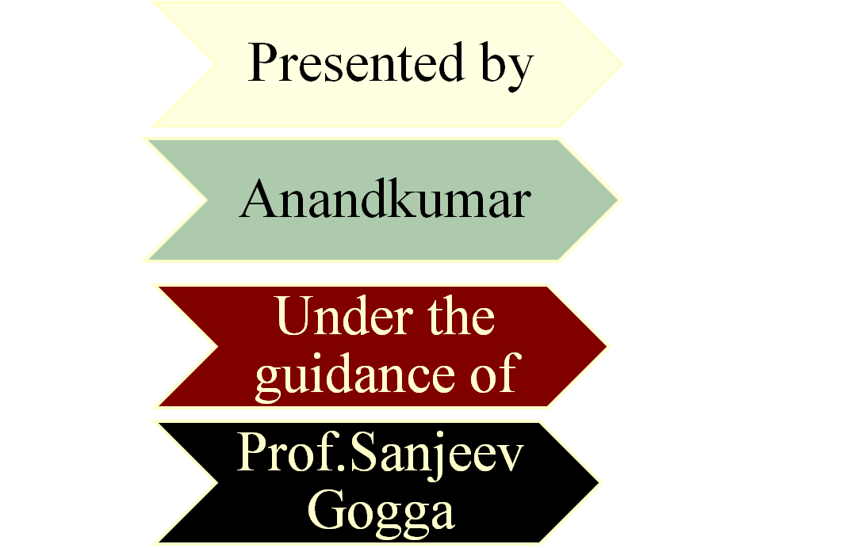
Seminar on
“NEXT GENERATION FREE SPACE OPTICS SYSTEM IN WIRELESS COMMUNICATION TECHNLOGY”

Slide 3
Presentation Overview
Introduction
What is Free Space Optics (FSO)?
Why FSO?
Need for FSO
History of FSO
Block Diagram
How FSO Works?
Different Topologies of FSO Networks
Technology & Wavelength
Applications
Advantages & disadvantages
Challenges faced by FSO
Conclusion
References

Slide 4
INTRODUCTION
FSO is a wireless technology that transmit data via laser beams
FSO uses a light to transmit data between buildings that have a clear line of sight(LOS)
Currently it can allow up to 2.5gbps of data rate but can increases to 10gbps using WDM (wavelength division multiplexing)
FSO is based on connectivity between two stations consisting of optical transcivers with a laser Tx and laser Rx to provide full duplex communication
Free space link behave as similarly to a fiber optic system

Slide 5
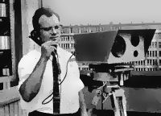
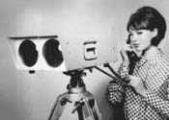
History of FSO
Its old technology! Originally developed for NASA and the military in the 1960s by a German scientist Dr.Erhard Kube also known ‘Father of FSO technology’ well before Fiber Optic Cables
Recently FSO entered into the field of Telecommunications due to its fast accessing technology

Slide 6
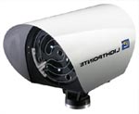
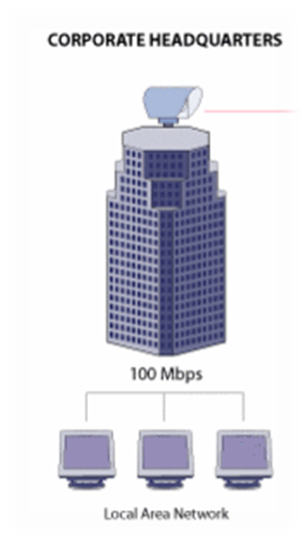
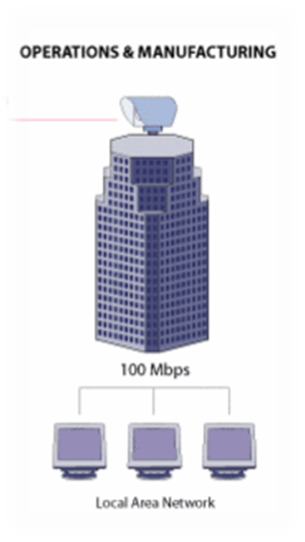
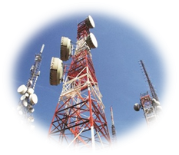
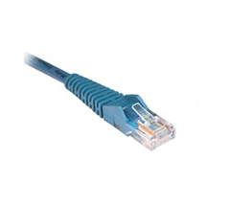
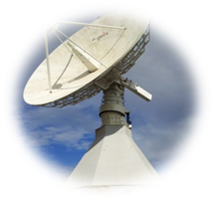
What is Free Space Optics (FSO)?
FSO - optical communication technology that uses light propagating in free space to transfer data.
Shortcut to broadband
Lack of infrastructure
Last mile challenges
Cost, competitive and regulatory issues

Slide 7
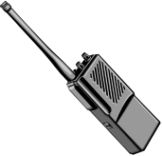


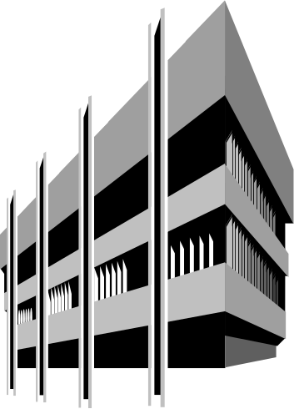



Why FSO?
Laser Link
-High Speed
-No frequency license
-Secure
-Rapid deployment
Microwave
Frequency license
Speed
Microwave
Frequency license
Speed
Security?
Headquarters
Branch Office
Fiber Optic Cable
Expensive
Long installation time

Slide 8
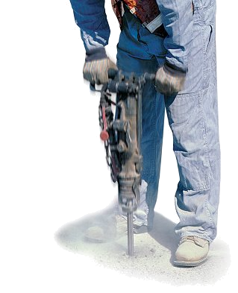
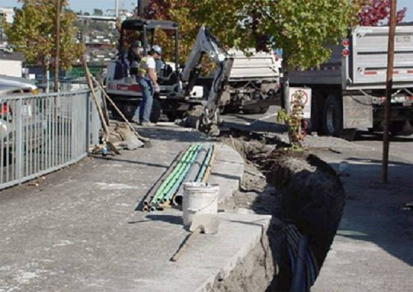
Why Free Space Optics?
Why Just Bury More Fiber?
Cost
Rights of Way
Permits
Trenching
Time
With FSO, especially through the window, no permits, no digging, not more costly

Slide 9
Need for FSO
Fso can send large amount of data(around 2.5 gbps of data)
No need to get licence, the spectrum used is an unlicensed world wide
Can transmit data at distance around 8km (almost 4 and half miles)
Here we use Line of sight technology
The cost is often less than that of using fiber optic cables
Fso system can be installed quickly(in days)
Uses LED or Laser as a light source.

Slide 10
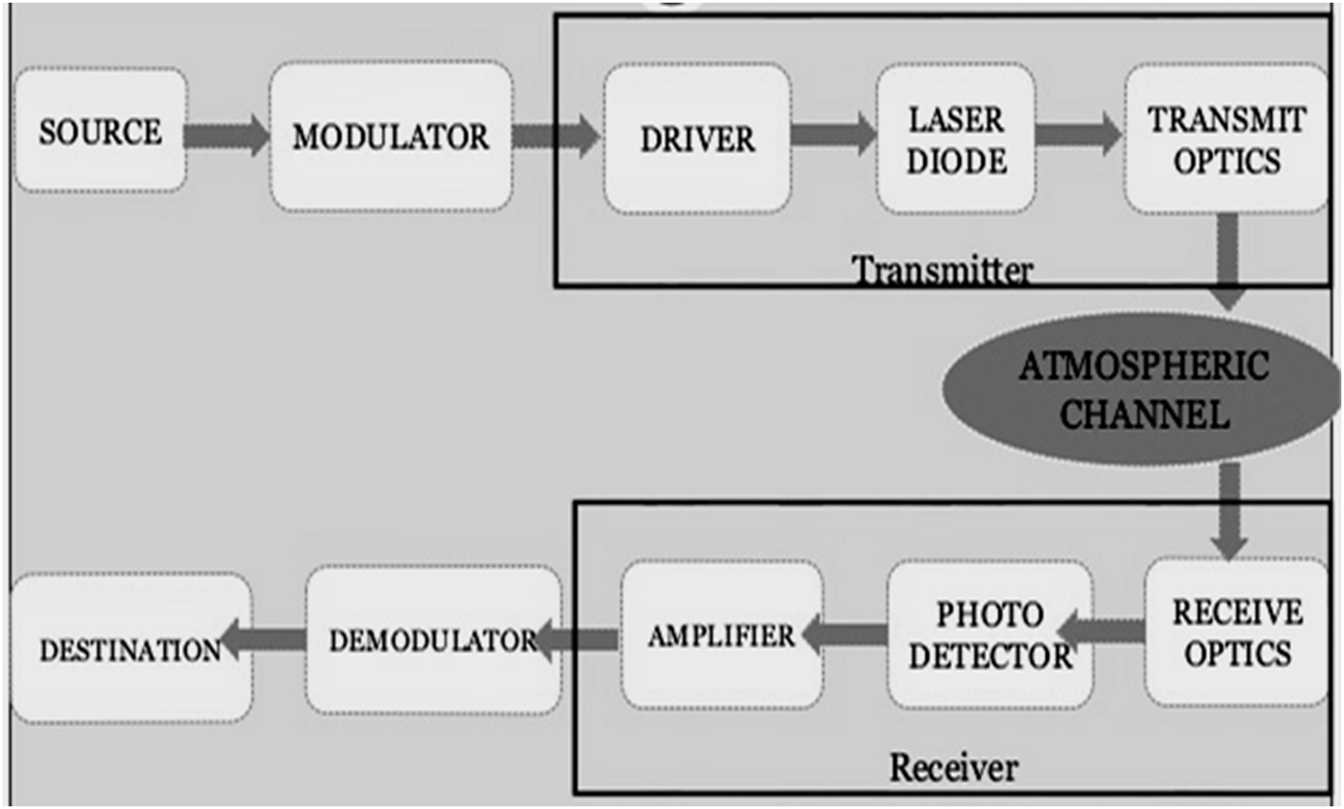
Block Diagram

Slide 11
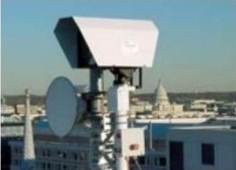


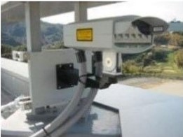

Slide 12




How FSO Works?
3
A receiver at the other end of the link collects the light using lenses and/or mirrors
2
Transmitter projects the carefully aimed light pulses into the air
5
Reverse direction data transported the same way.
  Full duplex
1
Network traffic converted into pulses of invisible light representing 1’s and 0’s
4
Received signal converted back into fiber or copper and connected to the network
Anything that can be done in fiber can be done with FSO

Slide 13

Transmission security
No side lobes
Highly secure
Efficient use of energy
Allows a very close spacing of links without interference
Ranges of 20m to more than 8km possible

Slide 14
Different Topologies of FSO Networks
Mesh Topology
Point to Multipoint Topology
Point to Point Topology
Ring Topology
Metro Network

Slide 15
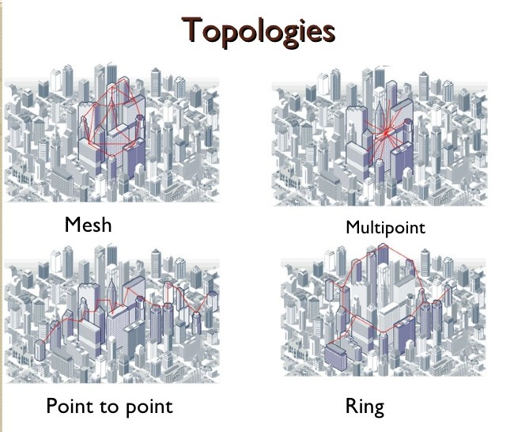

Slide 16
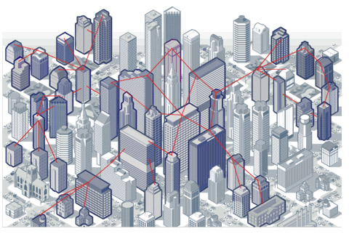
Typical Topology in a Metro Area

Slide 17
Technology
• An FSO unit consists of
1) Optical transceiver
2) Laser transmitter and receiver
• Uses lens on transmitter and receiver.
Wavelength
• FSO can operate into two wavelengths:
780-850 nm (353-385 THz)
1520-1600 nm (188-197 THz)

Slide 18
Applications
Metro Area Networks (MAN)
Last Mile Access
Enterprise connectivity
Fiber backup
Backhaul
Service acceleration

Slide 19
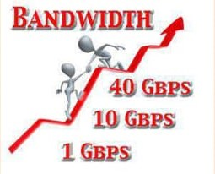
Advantages
Ease of installation
License-free operation
High bit rates
Low bit error rates
Immunity to electromagnetic interference
Full duplex operation
Very secure due to the high directionality and narrowness of the beam(s)

Slide 20
Disadvantages
Rain
Fog (10..~100 dB/km attenuation)
Pollution / smog
If the sun goes exactly behind the transmitter, it can swamp the signal.

Slide 21
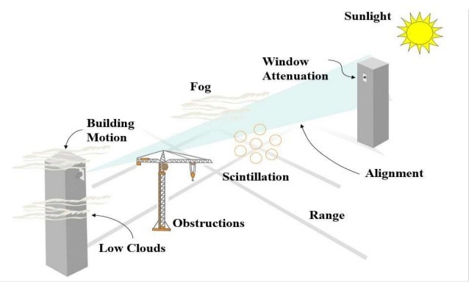
Challenges faced by FSO

Slide 22
Conclusion
Fso technology will be good alternative for the fixed wireless broadband communications. It provides high bandwidth near to the optical fiber capacity,short-time installation and low cost. It can send higher data rates

Slide 23
REFERENCES:
Chaudhary, Laxmi, Sudha Yadav, and Rohit Mathur. "Next generation free space optics system in wireless communication technology." International Journal of Advances in Electrical and Electronics Engineering (IJAEEE, ISSN: 2319-1112) 1.02 (2012): 255-261.
Willebrand, Heinz, and Baksheesh S. Ghuman. Free space optics: enabling optical connectivity in today's networks. SAMS publishing, 2002.
M. A. Khalighi and M. Uysal, "Survey on Free Space Optical Communication: A Communication Theory Perspective," in IEEE Communications Surveys & Tutorials, vol. 16, no. 4, pp. 2231-2258, Fourthquarter 2014.
Chan, Vincent WS. "Free-space optical communications." Journal of Lightwave technology 24.12 (2006): 4750-4762.
Komine, Toshihiko, and Masao Nakagawa. "Fundamental analysis for visible-light communication system using LED lights." IEEE transactions on Consumer Electronics 50.1 (2004): 100-107.
Cvijetic N. OFDM for next-generation optical access networks. Journal of lightwave technology. 2011 Aug 29;30(4):384-98.
Murugan, KH Shakthi, and M. Sumathi. "Design and Analysis of 5G Optical Communication System for Various Filtering Operations using Wireless Optical Transmission." Results in Physics 12 (2019): 460-468.
D. M. Jeganathan and D. P. Ionov. (2001, Dec 27). Multi-Gigabitsper- second optical wireless communications [Online]. Available: www.freespaceoptic.com

Slide 24


